Slide 1
Measuring Malaria in Complex Transmission Systems
Alec Georgoff
[DATE]

Slide 2
Background
Ross-Macdonald Model
Simplest basic model of transmission
“Theoretical scaffolding” of a malaria transmission model
Basic Reproductive Number (R₀)
R₀ > 1 → Transmission sustained (endemic)
R₀ < 1 → Transmission will die out
Forest Malaria
Major problem in GMS
Unique transmission landscape

Slide 3
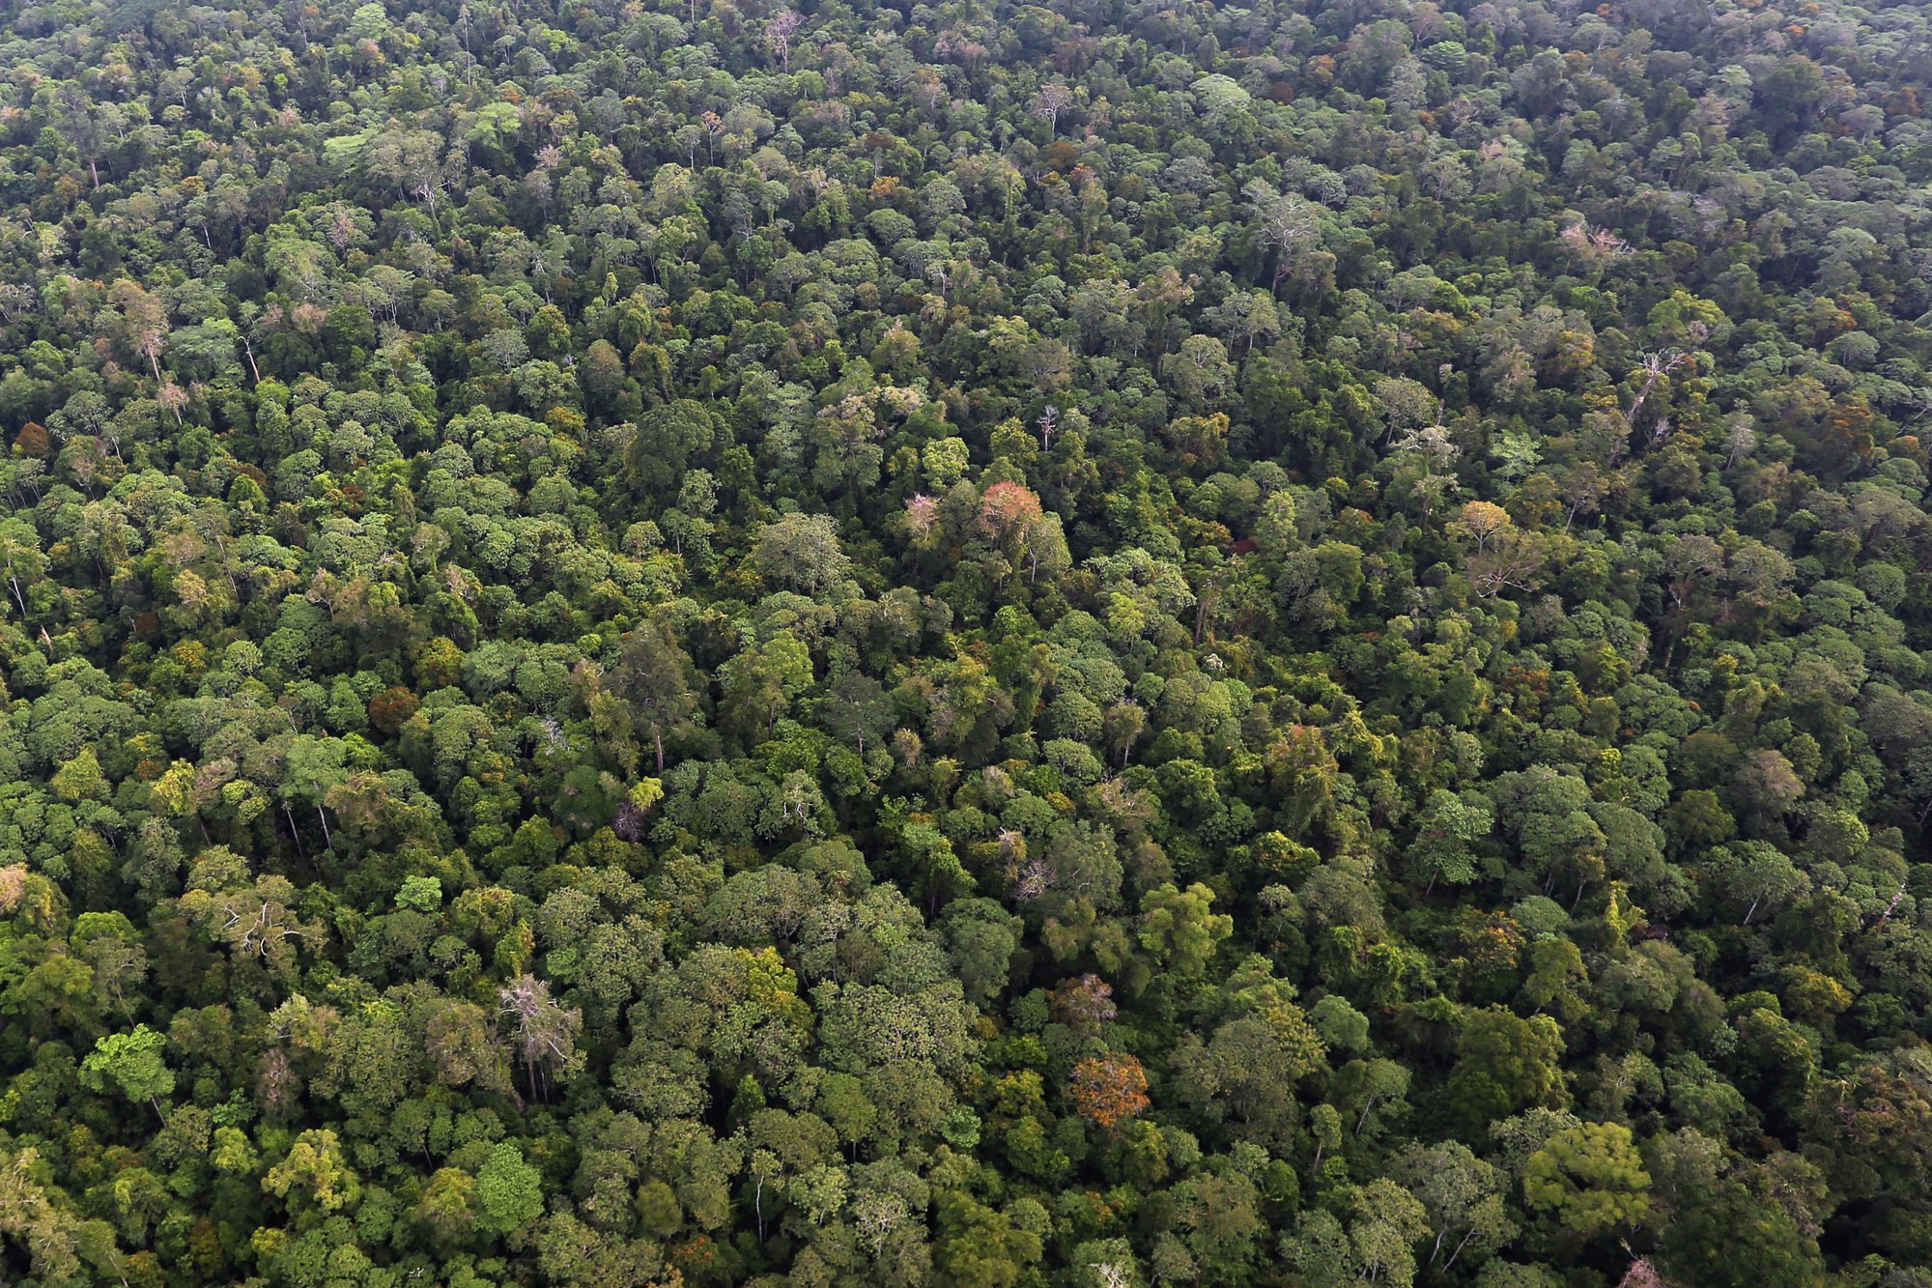
Forest Malaria
Village
Village
Village

Slide 4
Forest Malaria – Simplified System
Simplify to one village & one forest
Village

Slide 5
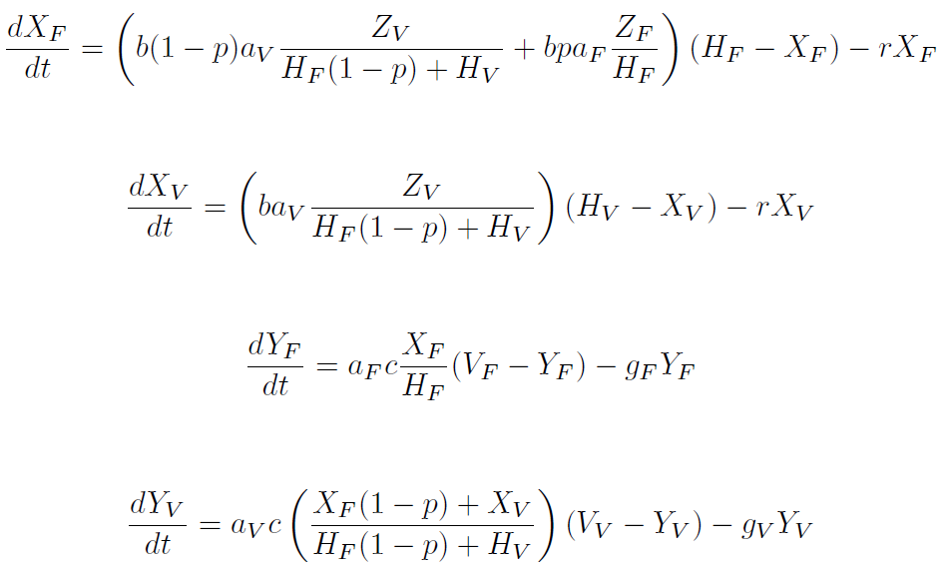
Forest Malaria – Simplified System
System governed by four ODEs:
Infected Humans (Forest):
Infected Humans (Village):
Infected Mosquitoes (Forest):
Infected Mosquitoes (Village):

Slide 6
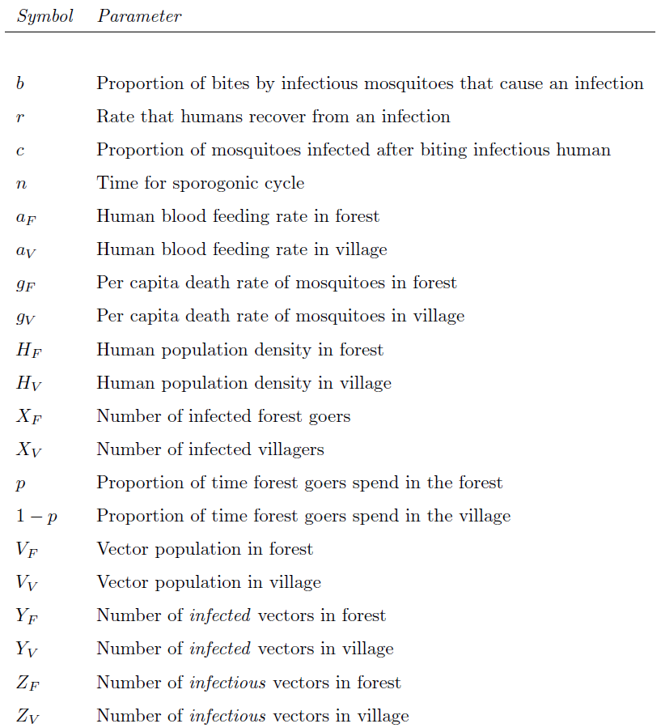
Forest Malaria – Simplified System

Slide 7
Forest Malaria – Simplified System

Slide 8
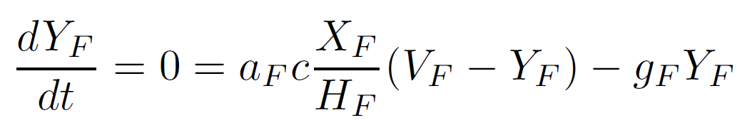
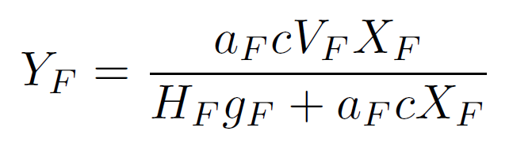
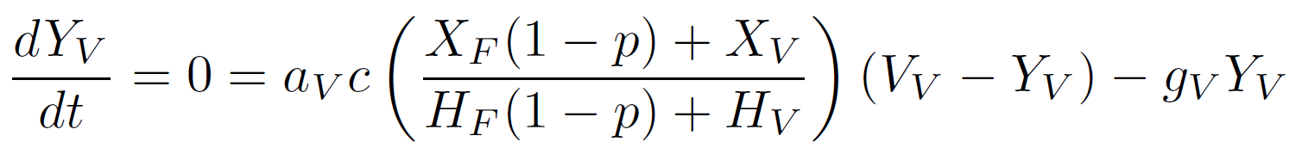
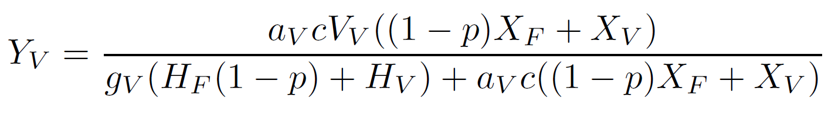
Assume Equilibrium Mosquito Populations

Slide 9
Assume Equilibrium Mosquito Populations

Slide 10
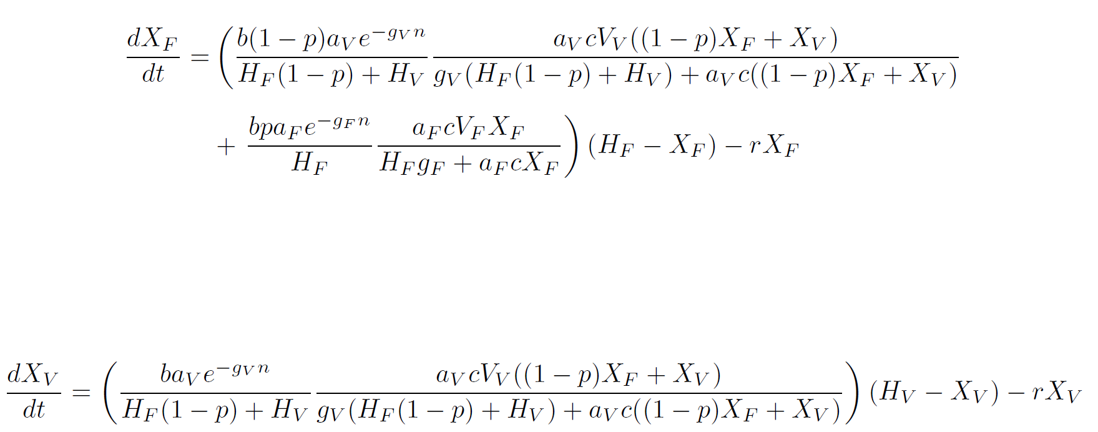
Insert Mosquito Populations Into Human Equations

Slide 11
Insert Mosquito Populations Into Human Equations

Slide 12
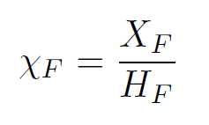
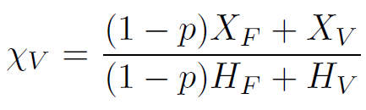
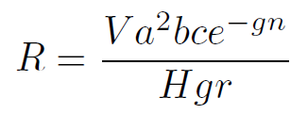
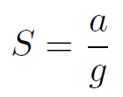
Simplify Equations
Additional Parameters:
Prevalence

Slide 13
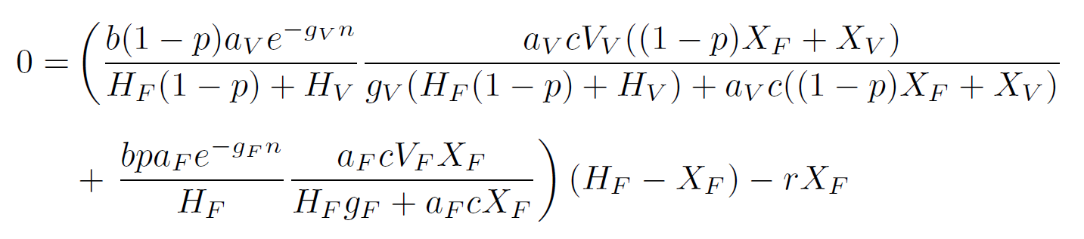

Simplify Equations

